Slide 1
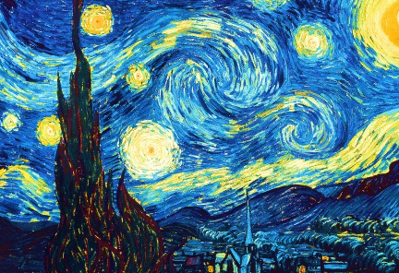

Artworks Generation and Prediction
Presented by:
Rashid Alsumaydi
Abdulelah Aldossari
Majed Alghamdi

Slide 2
METHODOLOGY
Introduction
Data Gathering
Models
Conclusion
Future Work

Slide 3
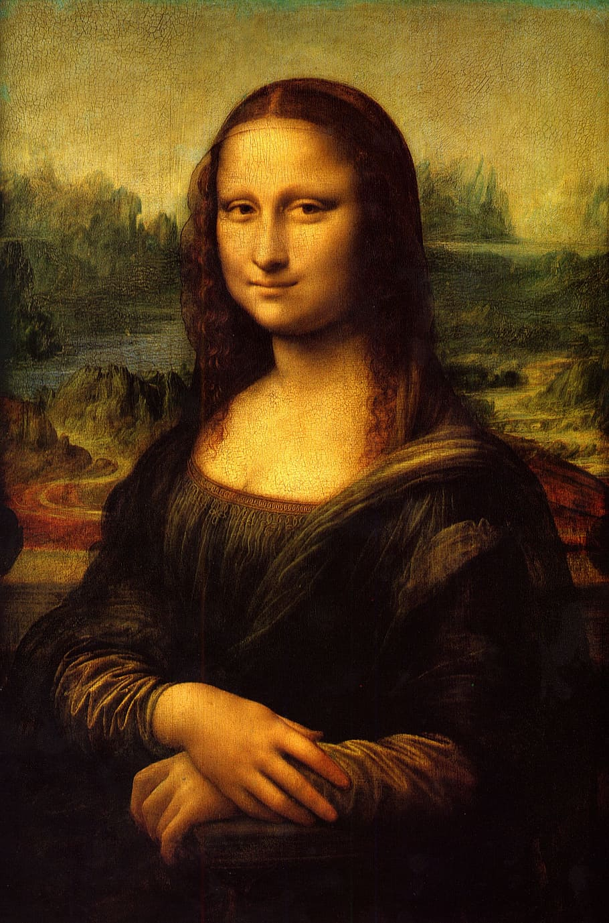
INTRODUCTION
We'll build two deep learning algorithms on a dataset of artworks for the most famous artists, which are CNN and GANs.
The goal is to generate new artworks. Also, predict the artwork belongs to which artist.

Slide 4
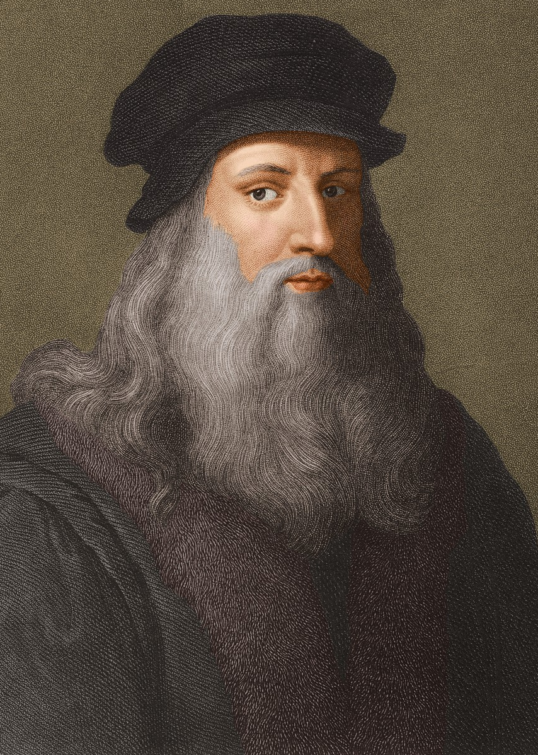
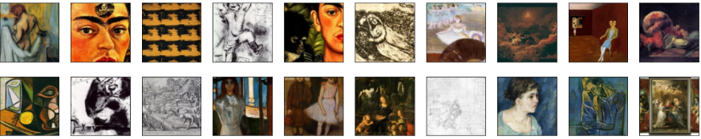
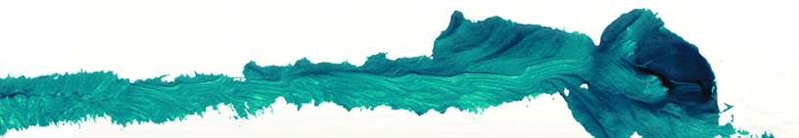
ABOUT DATASET
The dataset is called Best Artworks of All Time
It contains a collection of paintings of the 50 most influential artists of all time

Slide 5
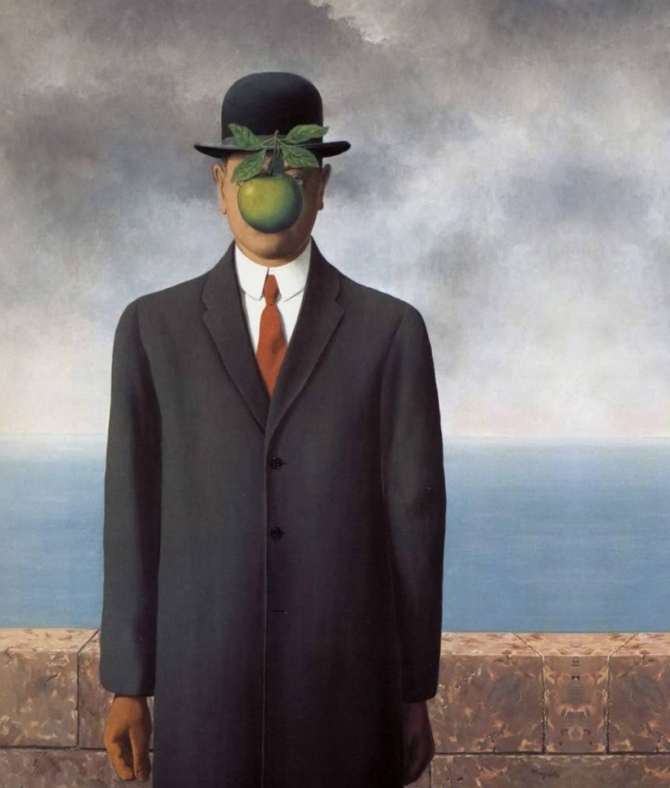
MODELS
We'll divide the project into two sections, which are:
Artworks Generation
Artworks Prediction

Slide 6
ARTWORKS GENERATION
Train Loader:
img_size | batch_size
32 | 48
Networks:
Optimizers:
padding | stride | activation | kernel_size | Network
1 | 2 | leaky_relu | 4 | Discriminator
1 | 2 | Relu, tanh | 4 | Generator
β2 | β1 | lr | Optimizer
0.999 | 0.3 | 0.0001 | d_optimizer
0.999 | 0.3 | 0.0001 | g_optimizer
Build network:
z_size | g_conv_dim | d_conv_dim
100 | 128 | 128

Slide 7
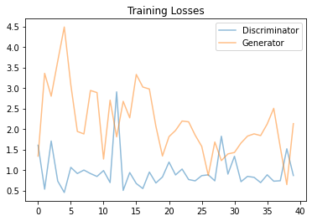
ARTWORKS GENERATION
n_epochs = 10
Training loss:

Slide 8
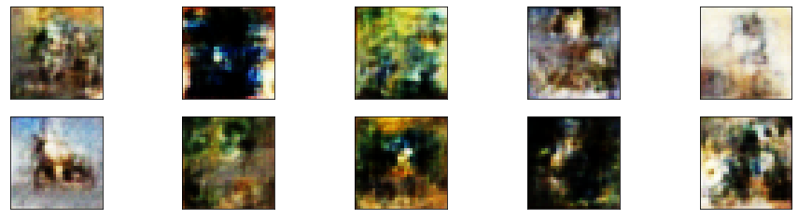
ARTWORKS GENERATION
Generate samples:

Slide 9
ARTWORKS PREDICTION
Model Parameters:
loss | optimizer | Output units | activation | strides | pool_size | kernel_size | input_shape
categorical_crossentropy | adam | 10 | Relu, softmax | 2 | 2 | 3 | 64, 64, 3
Model Evaluation:
val_acc | val_loss | acc | loss | epochs
0.8125 | 0.7344 | 0.8341 | 0.5038 | 75

Slide 10
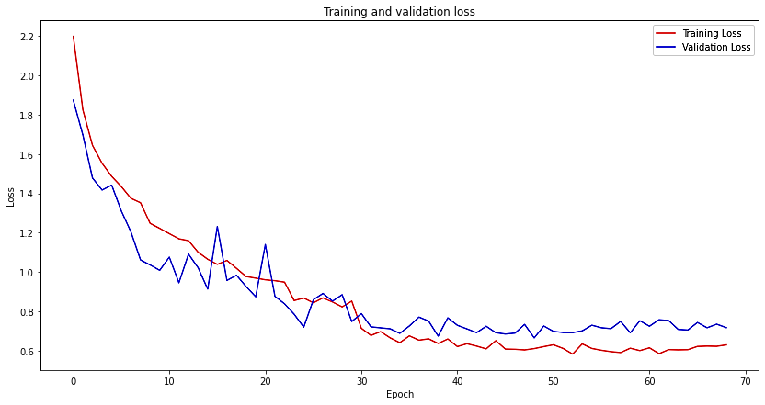
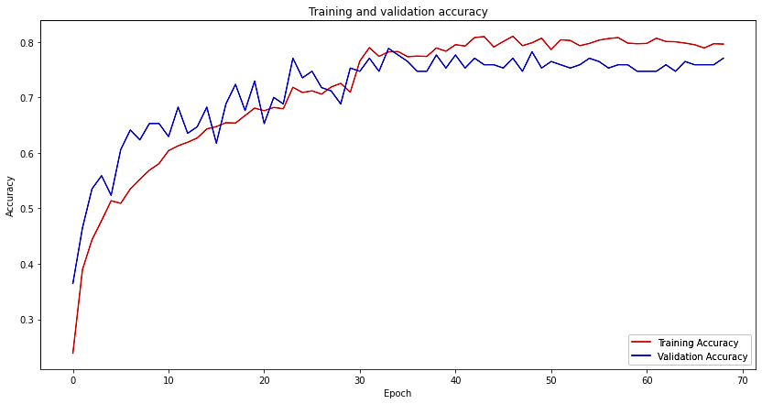
ARTWORKS PREDICTION
Relationship between loss and number of epoch:
Relationship between accuracy and number of epoch:

Slide 11
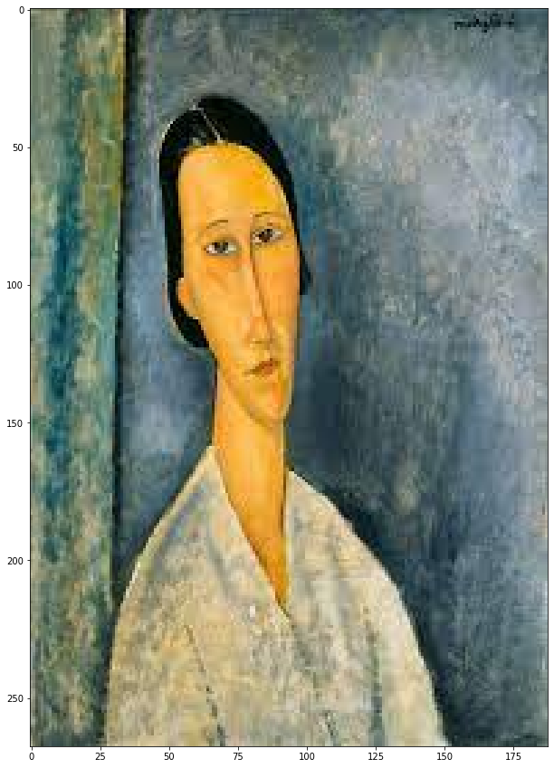
ARTWORKS PREDICTION
Using Sample to test the model:
Prediction:

Slide 12






TOOLS
Numpy
TensorFlow
Pandas
PyTorch
Computer Vision
Jupyter notebook

Slide 13
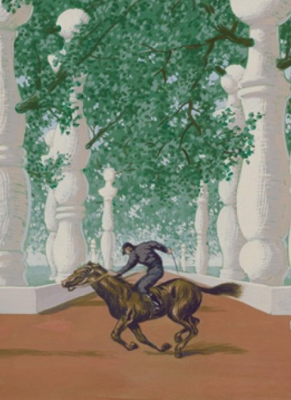
CONCLUSION
In Artworks Generation, the more powerful GPU, the better and clearer generated artworks
In Artworks Prediction, Relationship between accuracy and number of epochs is direct, but inverse between loss and number of epochs

Slide 14
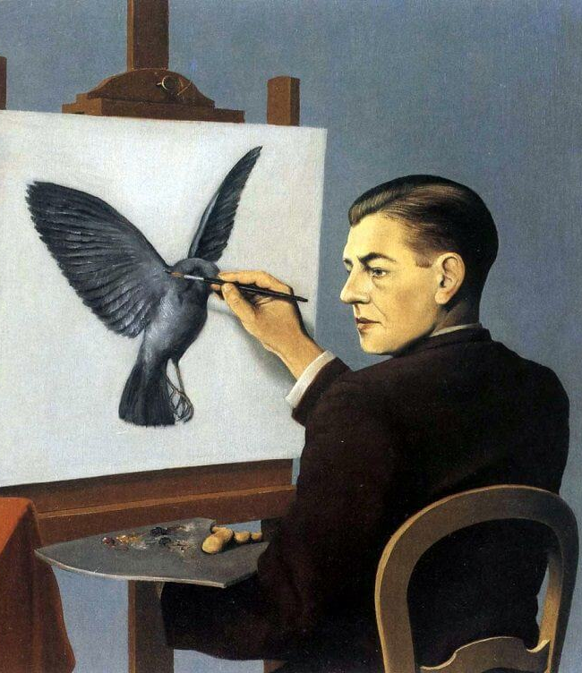
FUTURE WORK
Increase the number of epochs to give us better results
Working with more powerful GPU
Create a website that can generate artworks from the selected artists, also can predict the artist who made the uploaded artwork

Slide 15
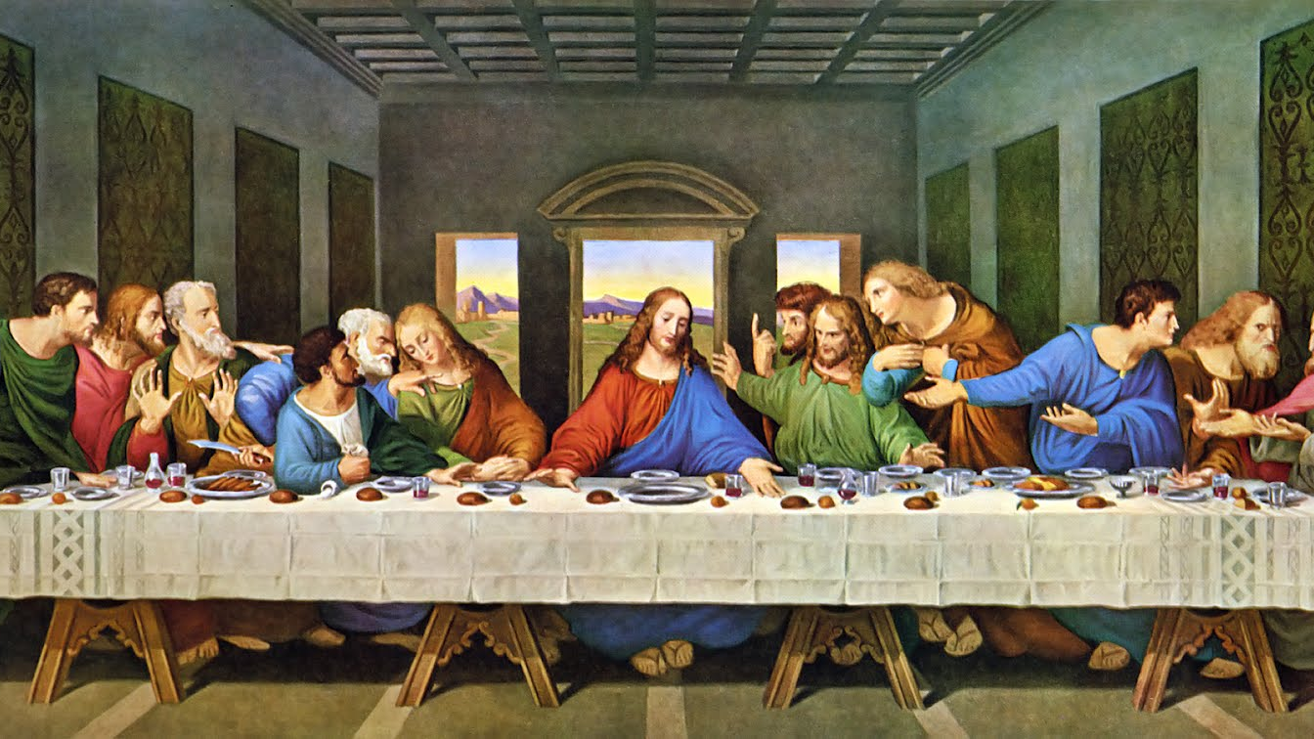
Thank you

